Slide 1

LOYOLA-ICAM COLLEGE
OF ENGINEERING AND TECHNOLOGY
Modelling and simulation of Direct torque control of Induction motor

Slide 2
Batch Details
S.No | Name | Department
1 | ALFRED JEROME G | III YEAR EEE - LICET
2 | ANDRIA MORAIS | III YEAR EEE - LICET
Guided by
Dr.P. Marshall Arockia Dass, AP/EEE
LICET

Slide 3
Objective
To Model and simulate the Induction motor (415V star connected, 4HP)
To simulate Direct torque control
To simulate space vector pulse width modulation techniques
Due to advantages such as fast dynamic response, simple and robust control structure, direct torque control (DTC) is commonly used method in high performance control method for induction motor.

Slide 4
Comparative study
Control Type | Torque Control | Flux Control | Response | Advantages | Disadvantages
DC Drive | Direct | Direct | High | High Accuracy, Good Torque | Motor Maintenance High Motor cost Encoder required for higher accuracy Poor Torque response
Scalar frequency Control | None | None | Low | No encoder simple | Low accuracy poor torque response
Flux Vector Control | Indirect | Direct | High | High Accuracy Good torque response | Encoder always required
Direct torque control | Direct | Direct | High | No encoder Moderate speed accuracy Excellent Torque Response | Encoder required for High speed Accuracy

Slide 5
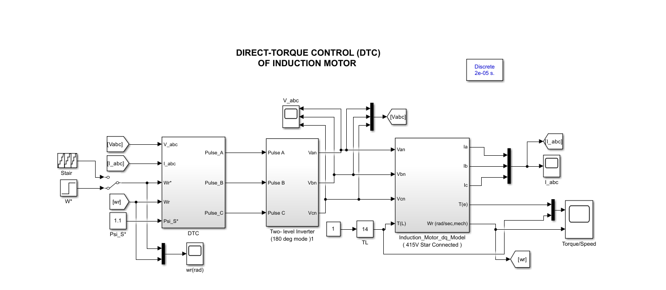

Slide 6
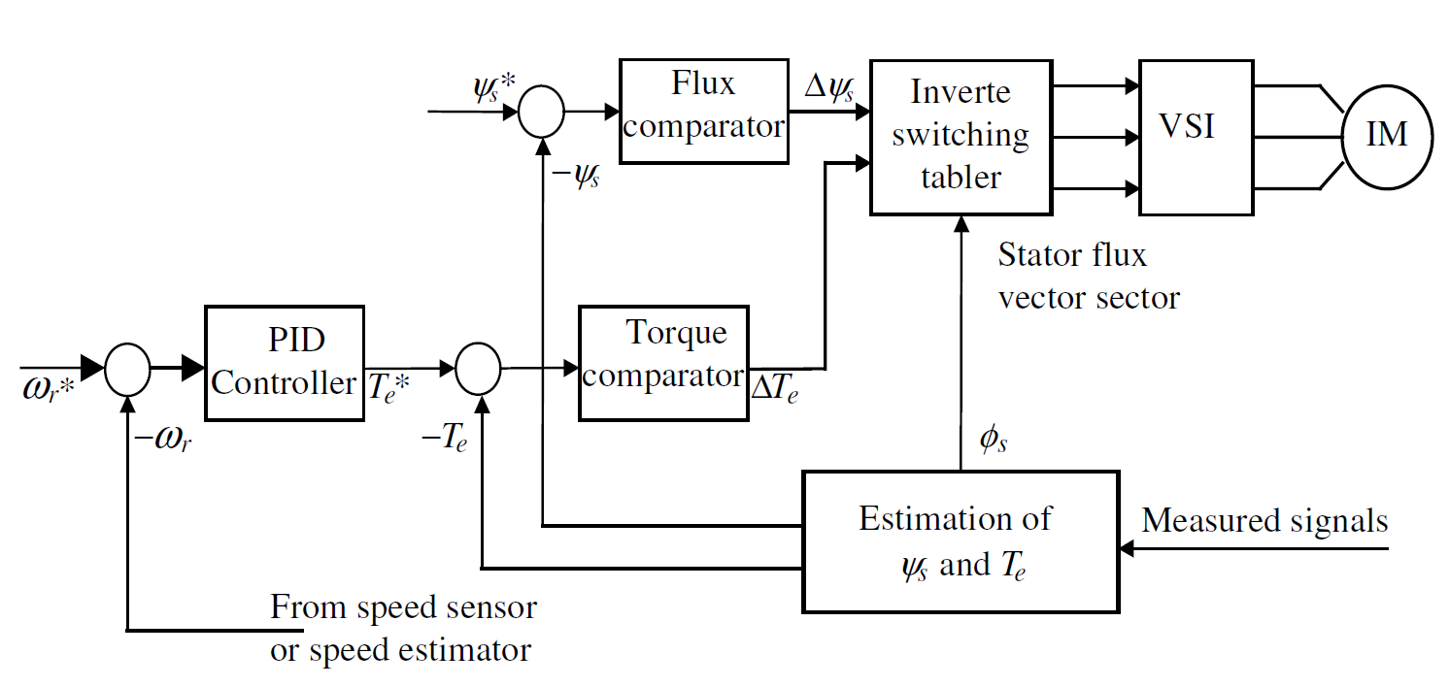
DTC of Induction Motor

Slide 7
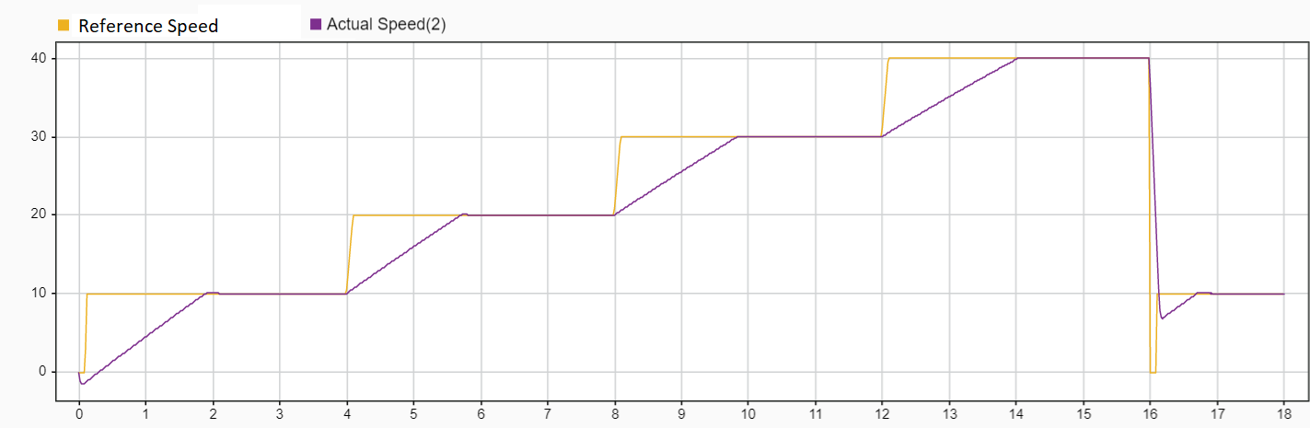
Simulation Results

Slide 8
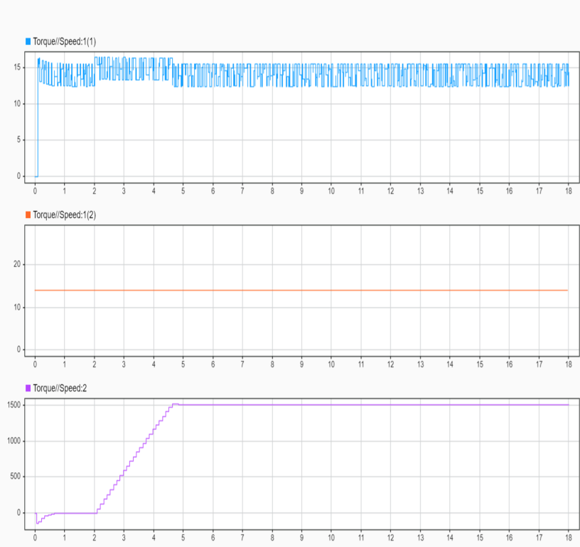
Simulation Results

Slide 9
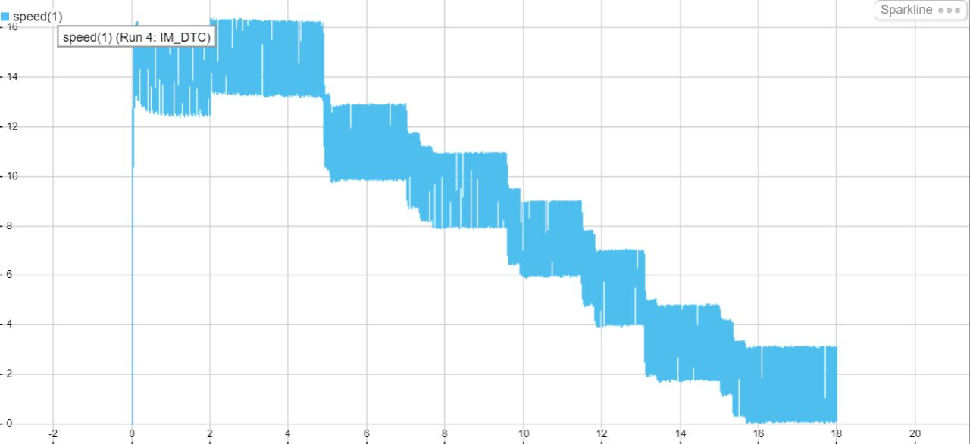
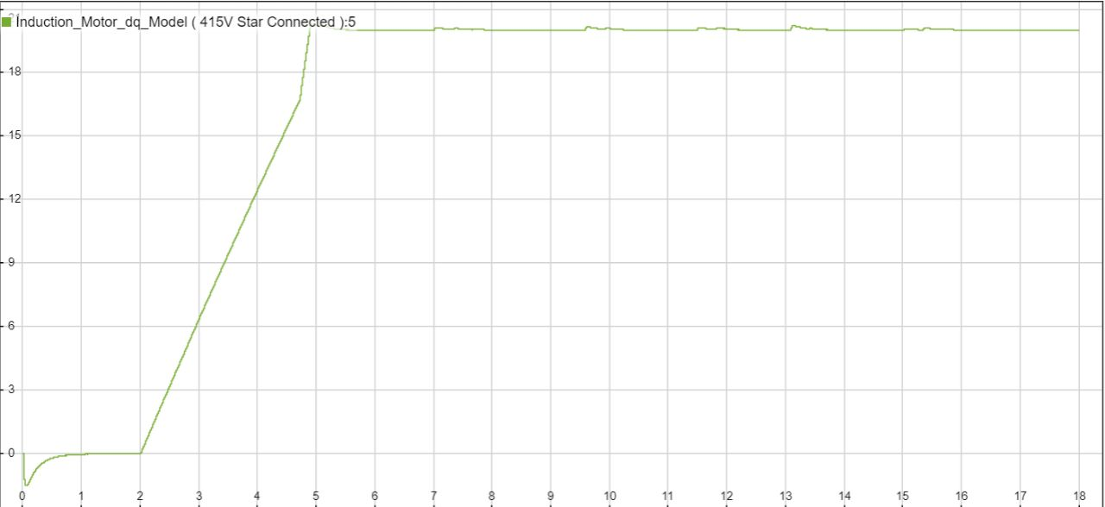

Slide 10
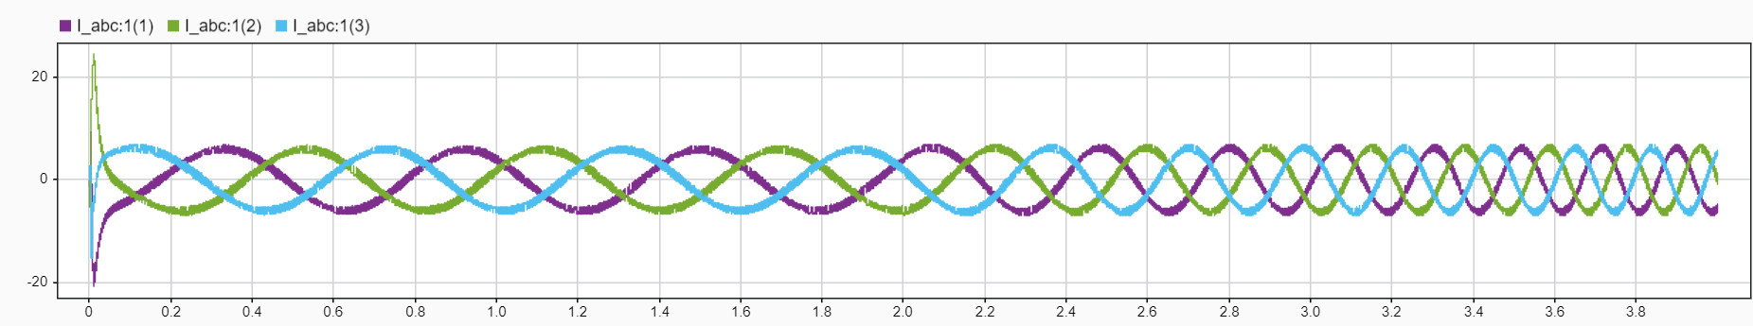
Stator phase current during full load operation of DTC speed control

Slide 11
Conclusion
Numerical simulation have been performed to investigate the effects of the proposed method on the overall system performance.
Low speed and rated speed performance of the motor were simulated at zero loads and rated loads working conditions.
The DTC method has faster acceleration time in transient state region and torque ripples were reduced with the proposed method in steady state region.

Slide 12
References
[1] T. Noguchi, I. Takahashi, “Quick torque response control of an induction motor based on a new concept,” (in Japanese), IEEJ Tech. Meeting Rotating Mach., vol. RM84–76, pp. 61–70, Sept. 1984.
[2] I. Takahashi, T. Noguchi, “A new quick-response and high efficiency control strategy of an induction machine,” IEEE Trans. on Ind.Applicat., vol. 22, pp. 820–827, Sep./Oct. 1986.
[3] I. Takahashi, Y. Ohmori, “High-performance direct torque control of an induction motor,” IEEE Trans. on Ind. Applicat., vol. 25, pp. 257–264, Mar./Apr. 1989.
[4] L. U. Gökdere and M. A. Simaan, “A passivity-based method for induction
motor control,” IEEE Trans. Ind. Electron., vol. 44, no. 5, pp.688–695, October 1997
[5] M. Depenbrock, “Direct self-control (DSC) of inverter-fed induction machine,” IEEE Trans. on Power Electron., vol. 3, pp. 420–429, Oct. 1988.
[6] M. Depenbrock, A. Steimel, “High power traction drives and convertors,” in Proc. Elect. Drives Symp.’90, Capri, 1990, pp. 1–9.
[7] I. Boldea, S.A. Nasar, “Torque vector control (TVC)–A class of fast and robust torque speed and position digital controller for electric drives,” in Proc. EMPS’88 Conf., vol. 15, 1988, pp. 135–148.
[8] T. Ohtani, N. Takada, K. Tanaka, “Vector control of induction motor without shaft encoder,” IEEE Trans. on Ind. Applicat., vol. 28, no. 1, Jan./Feb. 1992, pp. 157-164.
[9] D. Casadei, G. Grandi, G. Serra, “Study and implementation of a simplified and efficient digital vector controller for induction motors,” in Proc. EMD’93, Oxford, U.K., Sept. 8–10, 1993, pp. 196–201.

Slide 13
[10] D. Casadei, G. Grandi, G. Serra, A. Tani, “Effects of flux and torque hysteresis band amplitude in direct torque control of induction machines,” in Proc. IECON’94, Bologna, Italy, Sept. 5–9, 1994, pp.299–304.
[11] D. Casadei, G. Grandi, G. Serra, A. Tani, “Switching strategies in ICEM, Helsinki, Aug. 20–24, 2000.
[12] P. J. Nicklasson, R. Ortega, and G. Espinosa, “Passivity-based control of a class of Blondel–Park transformable machines,” IEEE Trans. Auto. Contr., vol. 42, pp. 629–647, May 1997.
[13] R. Ortega, A. Loria, P. J. Nicklasson, and H. Sira-Ramirez, “Passivity-based control of Euler–Lagrange systems,” in Communications and Control Engineering. Berlin, Germany: Springer-Verlag, 1998.
[14] Ph. Martin and P. Rouchon, “Two simple flux observers for induction motors,” Int. J. Adaptive Control Signal Processing, vol. 14, no. 2–3,2000.
[15] I. Takahashi and T. Noguchi, “A new quick response and high efficiency control strategy of an induction motor,” IEEE Trans. Ind. Electron., vol. IE-22, Sept. 1986.
[16] D. G. Taylor, “Nonlinear control of electric machines: An overview,” IEEE Contr. Syst. Mag., vol. 14, no. 6, pp. 41–51, 1994.
[17] A. J. van der Schaft and J. M. Schumacher, An Introduction to Hybrid Dynamical Systems, ser. Springer Lecture Notes in Control and Information Sciences 251. London, U.K.: Springer Verlag, vol. 174.

Slide 14
Thank you !

